Slide 2
Developing Cross Platform Apps using Cognitive Services API
Khiem-Kim Ho Xuan

Slide 3
Overview
Introduction
Apis and cool stuff
How to register
Live code samples and demo
The cons

Slide 4



Introduction
(formerly Project Oxford) are a set of APIs, SDKs and services available to developers to make their applications more intelligent, engaging and discoverable
Enables natural and contextual interaction that augments user experiences
Uses Machine-based AI. Give your apps a human side

Slide 5
Apis and cool stuffs
In total there are 22 APIs available in Cognitive Services now
Be cool! Publish your own app:
https://www.microsoft.com/cognitive-services/en-us/applications
Extend Cognitive Services with Bots framework!
Get Started now!
https://www.microsoft.com/cognitive-services/en-us/computer-vision-api/documentation/getstarted/getstartedvisionapiforwindows

Slide 6
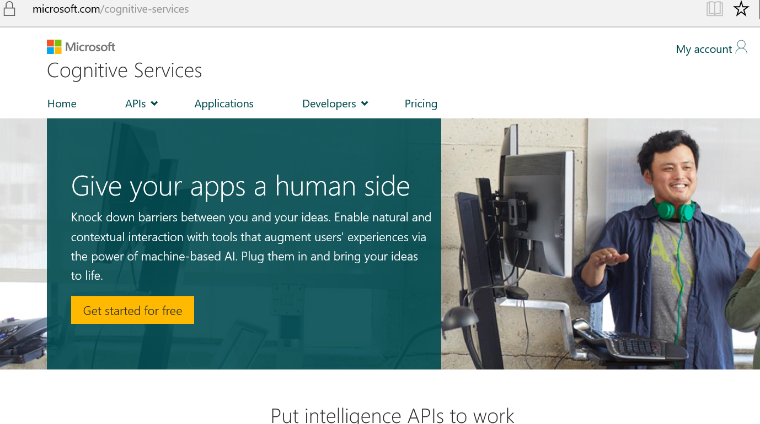
How to register
Go to: https://microsoft.com/cognitive-services
Have a microsoft account
Enable the API’s you want
Ugh use Microsoft IE or Edge.

Slide 7
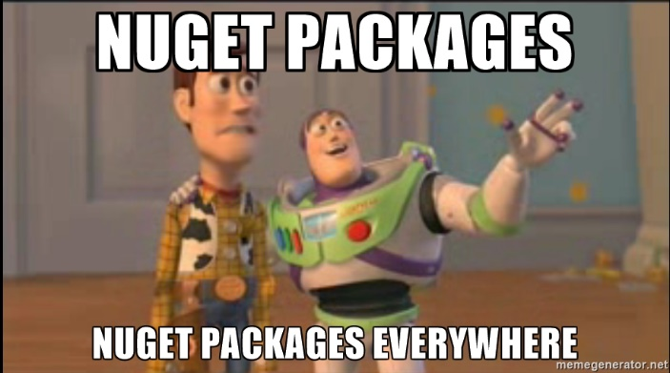




Live code samples and demo

Slide 8
The cons
Pricing!? (free from 5000- 30000 api calls per month)
Microsoft IE or Edge to login?
Still in preview
PCL limited support ☹ (most cognitive services are not yet available for Xamarin.Forms)
API key per API?!

Slide 9
Thank you!

